Slide 1

Virtual Vigilance using CNN
Urvi Padelkar(21107054)
Pranjal Desai(21107062)
Dhanashree Kasar(21107037)
Vineet Mhatre(22207009)
Project Guide
Prof.Poonam Pangarkar

Slide 2
Outline
Introduction
Literature Survey of the existing systems
Limitations of the existing systems
Problem statement
System Design
Technologies and methodologies
Implementation
Conclusion
References

Slide 3
Introduction
Virtual Vigilance is a process that assesses a test-taking individual's behaviour, environment, and movement, similar to a human proctor.
With the rise of online learning platforms and remote assessments, educational institutions are facing new challenges in preventing malpractice.

Slide 4
Motivation
The motivation behind research in virtual vigilance lies in addressing the challenges of examination supervision. We aim to develop proctoring tools that are user-friendly, scalable, and capable of accurately detecting and preventing academic dishonesty.
The motivation behind research in CNN-based image classification promises enhancing the precision and to detect unfair means.

Slide 5
Problem Statement
Problem Identified:
Malicious activities are carried out during online examination such as screen sharing and proxy testing etc.
Solution Proposed:
These are designed to combat online exam cheating by monitoring students during the test. They can use facial recognition to verify the identity of the test taker, track eye movements to ensure focus on the exam, and detect suspicious behaviours.

Slide 6
Objectives
To monitor test-takers in real-time, use cameras for data capture. Employ computer vision to detect cheating behaviours like eye movements , head movement and lip movement
To implement screen capture and activity tracking algorithms on test-taker devices to monitor behavior continuously during the test.
To develop an interface that displays warnings directly to the test-taker upon detecting suspicious behavior. Implement a warning counter that triggers automatic closure of the test interface after reaching a predefined threshold, typically 5 warnings.

Slide 7
Literature Survey of existing system
“Review and evaluation of Eye Movement Event Detection Algorithm” [1] provides evaluated event detection algorithms from different domains: the I-VT and I-DT from the threshold-based domain, the Random Forest model from machine learning and the CNN model from deep learning domains.
“A Novel Method for Lip Movement Detection using Deep Neural Network” [2] This work analyses the performance of different deep learning architectures such as AlexNet, VGG16, InceptionV1, ResNet50, Auto-Encoder and EfficientNet B0 and eccentric methods such as Q-ADBN over long sequences of lip images of the MIRACL-VC1 dataset.

Slide 8
Literature Survey of existing system
“Eye Tracking and Head Movement Detection” [3] The author highlights the significance of gaze estimation and tracking for various applications like human attention analysis and interactive user interfaces due to the unique geometric and motion characteristics of the eyes.

Slide 9
Limitations of existing systems
It offers promising solutions for monitoring online exams and preventing malpractice, it also comes with several limitations:
The technology is used to watch over tests might not understand things properly, leading to mistakes or wrong judgments.
The systems that monitor tests might have technical problems like bad internet or software issues that could disrupt the process.
Some students might find it hard to use or might not be able to use the monitoring technology, making it less accessible.
People might try to cheat the system by finding ways to trick or fool the monitoring technology.

Slide 10
Limitations of existing systems
Making sure the monitoring technology follows all the rules and laws about privacy and security can be tricky.
Even though technology can do a lot, it doesn't always understand things the way a human would, which might lead to mistakes or misunderstandings.
Some students might not trust the monitoring technology, feeling like they're being watched too closely or unfairly judged.
Students or educators might resist using virtual vigilance systems due to concerns about privacy, fairness, or effectiveness.

Slide 11
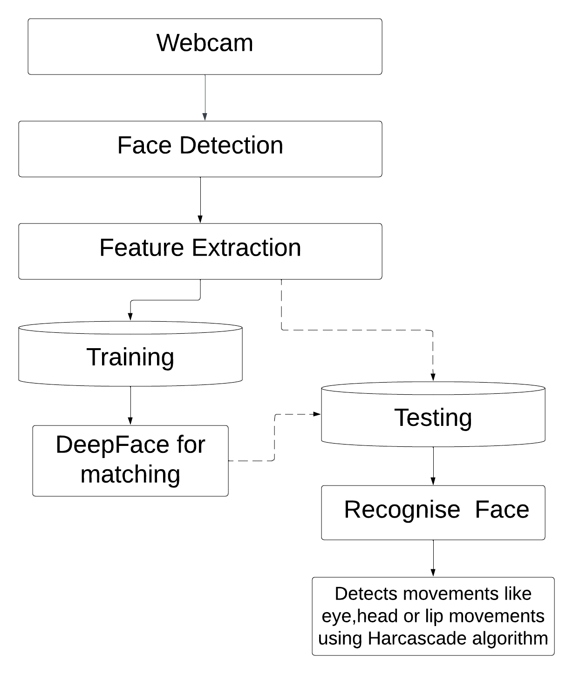
System Design

Slide 12
Technology Stack
Python 3.11.4
OpenCv2 4.9.0
DeepFace 0.0.84
Algorithm: -
CNN(Convolutional Neural Network): - CNN, like a brain for computers, helps them understand and analyse images by breaking them down into smaller pieces and learning patterns from them.
Harr Cascade Classifier: - The Haar Cascade Classifier is a machine learning algorithm used for object detection, particularly known for its application in face detection. It operates by training a classifier with positive and negative samples of the object to be detected.

Slide 13
Conclusion
Virtual vigilance employs artificial intelligence and machine learning algorithms to monitor online assessments. It uses behaviour analysis, environment monitoring, and real-time alerts to detect and prevent cheating. Despite its effectiveness, Virtual vigilance must address challenges such as privacy issues and technological limitations. Overall, it signifies a notable advancement in online education and assessment methodologies.

Slide 14
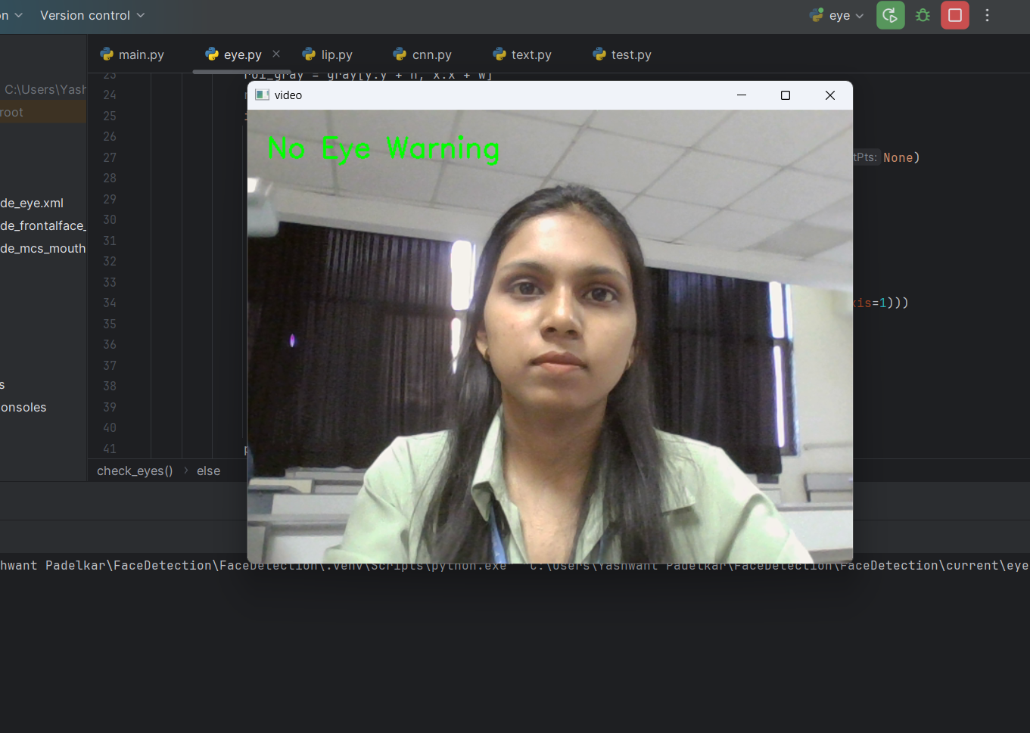
Implementation

Slide 15
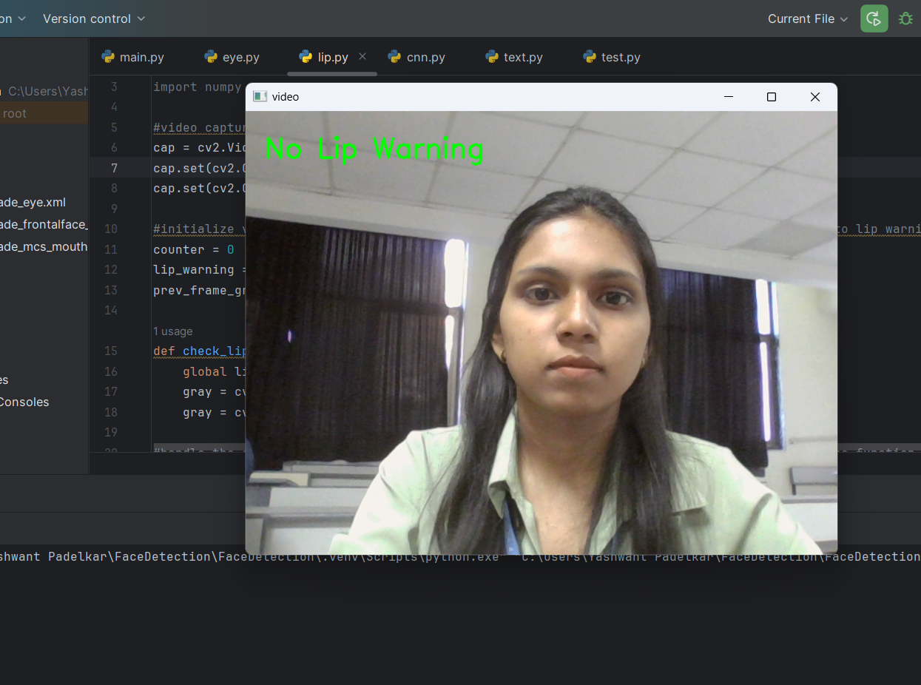
Implementation

Slide 16
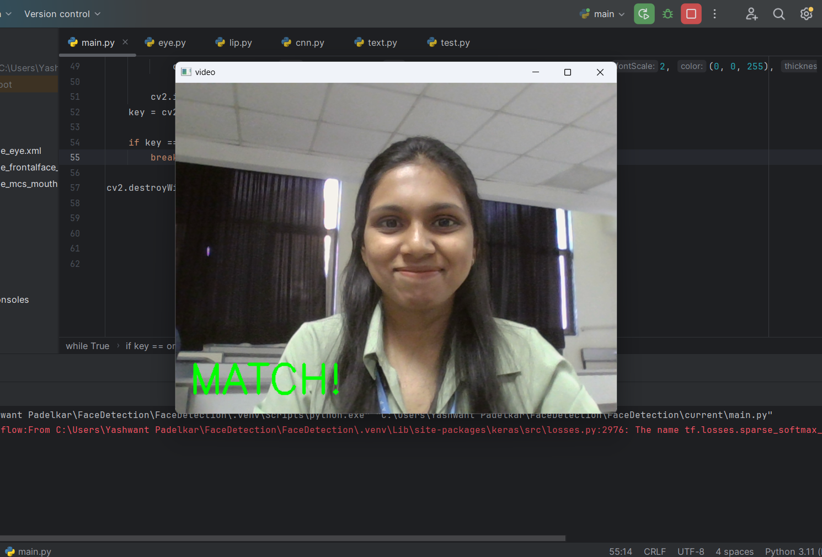
Implementation

Slide 17
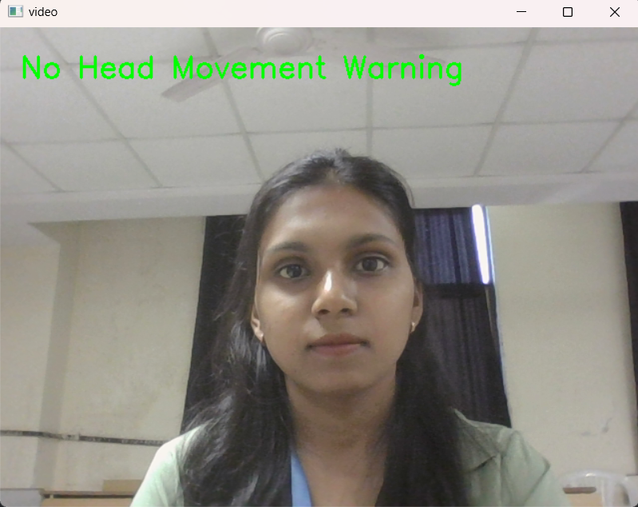
Implementation

Slide 18
References
[1] Birawo, B.; Kasprowski, P. Review and Evaluation of Eye Movement Event Detection Algorithms. Sensors 2022, 22, 8810.
[2] Srilakshmi, Kanagala, and R. Karthik. "A Novel Method for Lip Movement Detection using Deep Neural Network." Journal of Scientific & Industrial Research 81, no. 06 (2022): 643-650.
[3] Al-Rahayfeh and M. Faezipour, "Eye Tracking and Head Movement Detection: A State-of-Art Survey," in IEEE Journal of Translational Engineering in Health and Medicine, vol. 1, pp. 2100212 -2100212 , 2013, Art no. 2100212, doi: 10.1109/JTEHM.2013.2289879.

Slide 19
Thank You...!!

